Slide 1



Deep Neural Network On FPGA Midterm Presentation
Students:
Amit Shtober
Alon Nemirovsky
Supervisors:
Ina Rivkin
Oz Shmueli
Winter 2020-2021

Slide 2
Project Goals
Evaluate and validate the Xilinx Vitis-AI ecosystem :
1. Understanding Vitis-AI ecosystem
2. Running full flow from TensorFlow to the FPGA
Step #1 – Using trained model from Xilinx Zoo (resnet50)
Step #2 – Using untrained model from the Zoo (MNIST), Modify it and run the flow in order to fully understand the ecosystem ability
3. Evaluate and modify, when possible, each step in the process of the ecosystem
4. Creating a tutorial for running the flows step by step and indicate problems we have encountered in the process

Slide 3
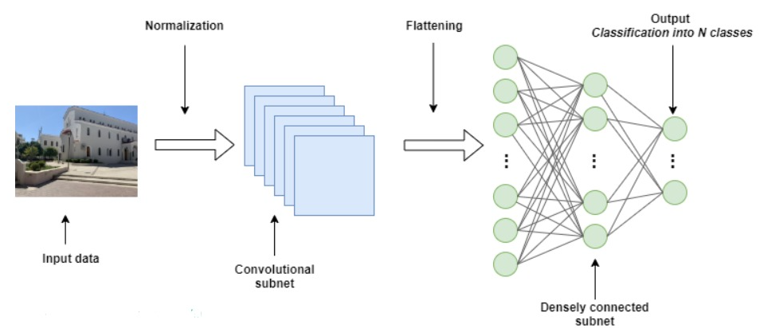
Deep Neural Network
Creation of Neural Network was inspired by the human brain and the way it functions
Works according to the algorithm and can predict a solution based on experience
The system has process layers that indicates on the depth of the Neural Network
This method is very popular and highly used today

Slide 4
Creating The Network
Full process of creating working neural network Includes:
Creating the model
Train it using CPU/GPU
Optimize the model
Inference which can be done on various machines such as host using GPU or dedicated Hardware
Create and manufacture the dedicated hardware which will run the Inference stage

Slide 5
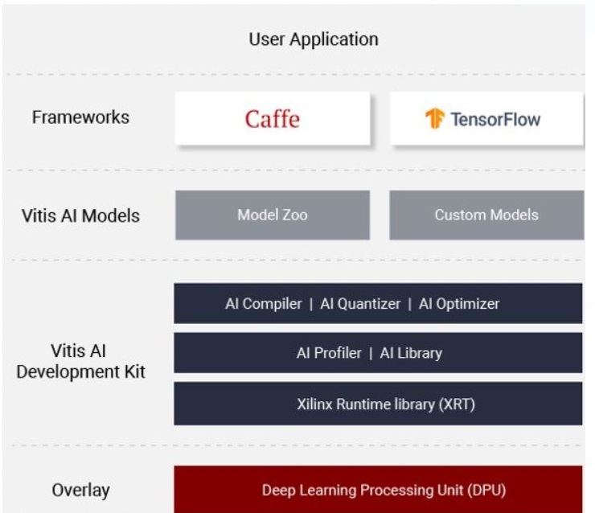
Vitis-AI Ecosystem
Xilinx offers a full ecosystem which helps deal with those problems. It includes:
Dedicated IP which called DPU
AI Zoo - Repository which includes optimized deep learning models. Great for quick start
Quantizer - Takes a floating-point model and performs pre-processing and then quantizes the weights/biases and activations to the given bit width
Compiler - Maps a network model into a highly optimized DPU instruction sequence

Slide 6
ZCU104 evaluation board
An integrated circuit designed to be configured by a designer using HDL
Great for parallel tasks (adders and multipliers)
USB
PL - FPGA
PS - ARM® Cortex™-A53 processor
UART
ETHERNET
SD CARD
ZCU104
evaluation
board
DDR4

Slide 7
Full Flow - Block Diagram
Fetch trained
Model
Xilinx Zoo
V-AI Quantizer
Trained Model
Quantized Model
V-AI Compiler
Train using
Tensorflow
Host code
VART based code, send instructions to the DPU
Transfer to the Host Code
Kernel code
Compiled Model DPU instruction set
Untrained Model
ZCU104 evaluation board
ARM run the host code
(also: CPU kernel instructions)
DPU kernel instructions
DPUS run the DPU instructions
DPU Verilog Xilinx IP
Results
The DPU IP Uploaded as a bitfile to the FPGA during board booting, using the SD CARD slot

Slide 8
Progress Status (1/2)
Setting up a VM with ubuntu using VMware
Initialize docker environment on the VM in order to use an exists image with Xilinx tools
Demands large storage
VirtualBox does not support FMA instructions, switched to VMware
Setting up the evaluation board
Flash the OS image and bit-file into the SD card and upload it to the evaluation board
Taking resnet-50 frozen model from Xilinx zoo, quantize and compile it using Xilinx tools and Running it on the board

Slide 9
Progress Status (2/2)
Create new model from scratch in TS and freeze it
Freezing the model in TS is complex. Demanded research in order to find a suitable way to do it
Quantize and Compile the model using Xilinx tools
The model output files works only using TensorFlow 1.x
The ecosystem having trouble use fully connected layers, therefore we used convolution layers
Dense-softmax layer failed in quantization stage. Used sigmoid layer as a workaround
The sigmoid layer couldn’t run on the DPU, only on the CPU
Create python Host script to run the model on the DPU/CPU
Running the model on the board

Slide 10
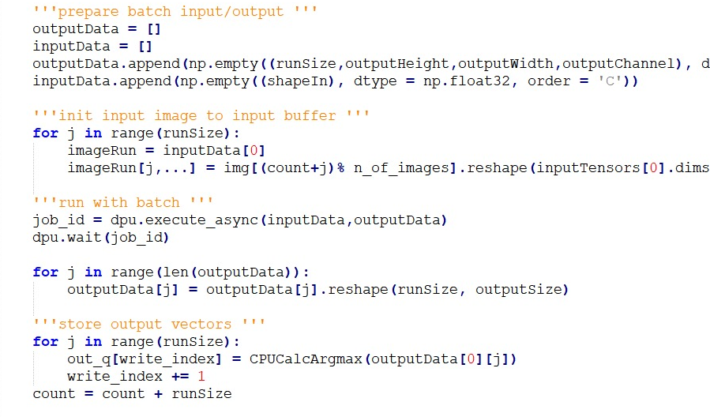
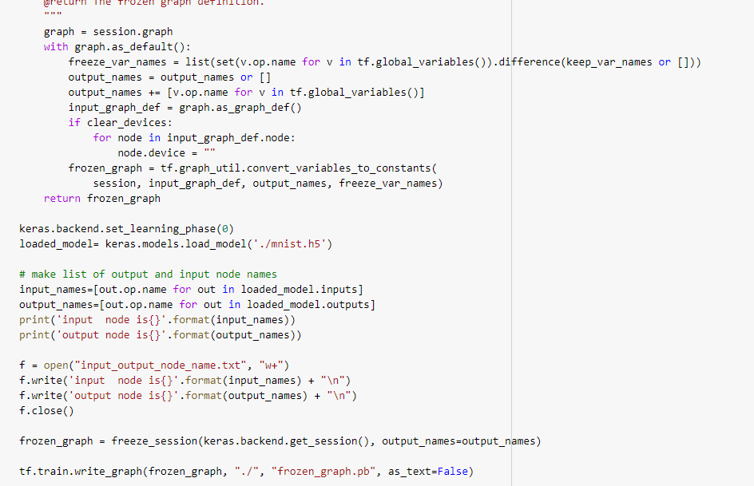
Freezing the model
Running the model on the board CPU

Slide 11
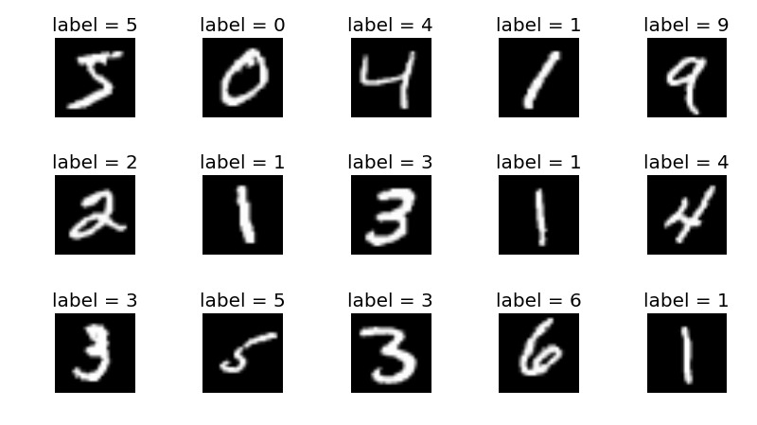
MNIST Classification Model
The MNIST handwritten digits dataset is a publicly available dataset that contains a total of 70k 8bit grayscale images each of which are 28pixels x 28pixels

Slide 12
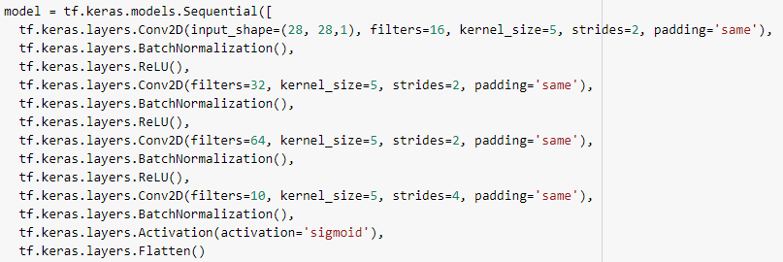
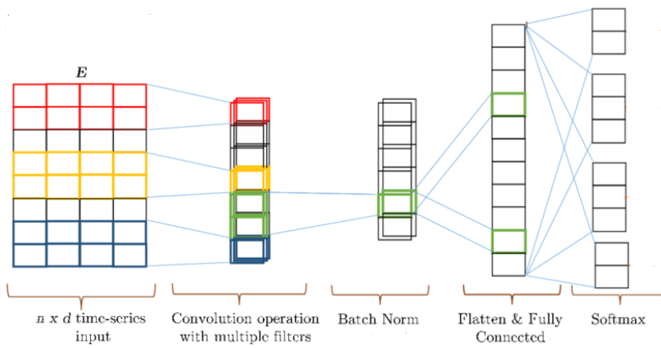
CNN

Slide 13

Flow Demonstration

Slide 14
What’s Next
Analyze the problems we faced so far in order to understand the cause and to investigate the limitation of the ecosystem
Modify parameters in the ecosystem in order to check the ecosystem robustness
Evaluate the inference performance of the board against the CPU
Fully understand the host code and the consequences of running some layers on the CPU and some on the DPU
Research about the DPU block design: fetch the RTL code from GitHub, Analyze and compile it
Complete the word tutorial

Slide 15
Schedule
Duration | Start Date | Task
Week | 21.10.20 | Reach basic understanding the product and its capabilities
Two and half weeks | 28.10.20 | Creating a Working environment for the tools
Two weeks | 15.11.20 | Running full procedure on the model resnet50 from Xilinx Zoo to the Board
3-4 weeks | 7.12.20 | Running full procedure on the model resnet50 from Tensorflow Zoo to the Board
Two weeks | 4.1.21 | Analyze problems and Modify parameters in the ecosystem
week | 11.1.21 | Evaluate the inference performance
week | 18.1.21 | Fully understand the host code and Research about the DPU block design

